Slide 1
Formal verification of TLS in the secure socket api
Presented by Cheyenne son and matthew christensen

Slide 2

The secure socket api
Using TLS is hard
Symbols in libssl: 504
Lines of code: 317
int socket = socket(PF_INET, SOCK_STREAM, IPPROTO_TCP);
int socket = socket(PF_INET, SOCK_STREAM, IPPROTO_TLS);
Notes:
Transfer of trust to library IPPROTO_TLS rather than relying on the developer to make the app secure

Slide 3
The problem
How do we know the Secure Socket API actually makes your socket secure?

Slide 4
Formal verification process
Contracts
Dafny
Code verification
Determine what state changes are necessary to maintain security.
Implement contracts and state changes in dafny code.
Verify that the codebase implements the contracts.

Slide 5
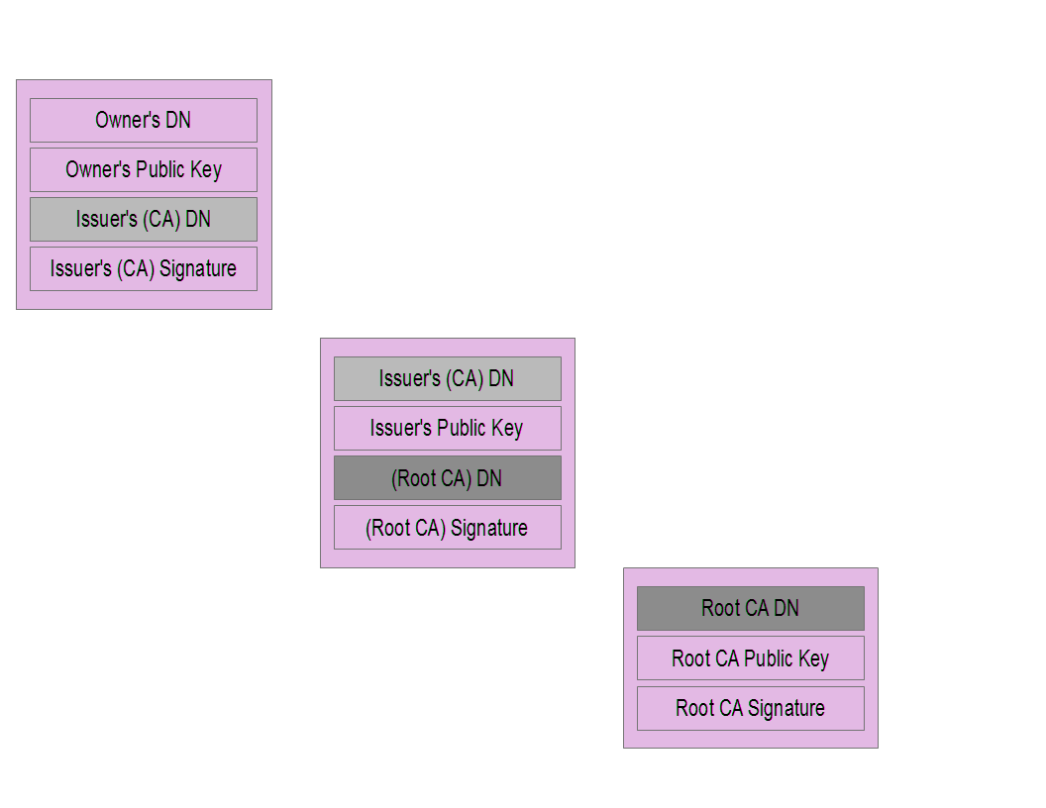
Certificate Chain

Slide 6
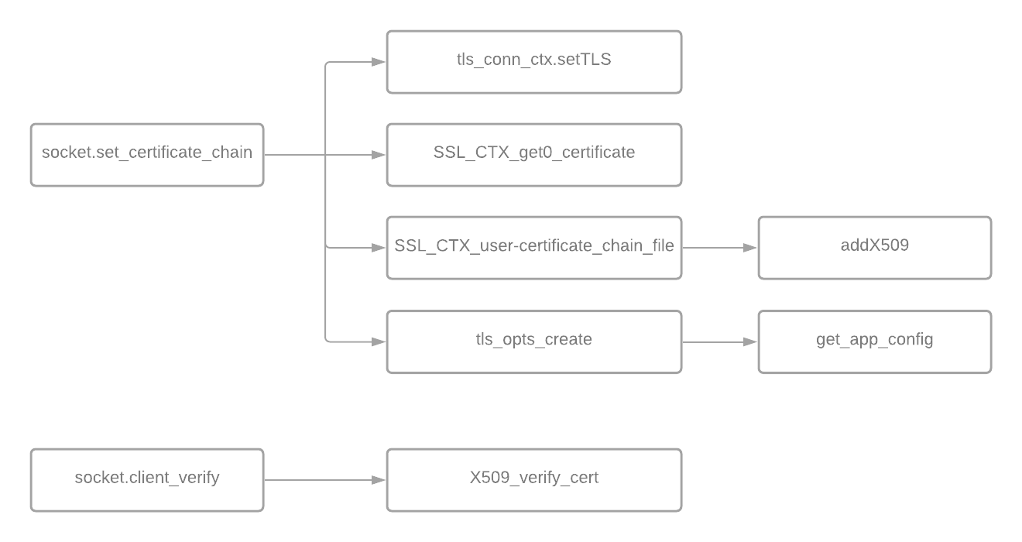

Slide 7
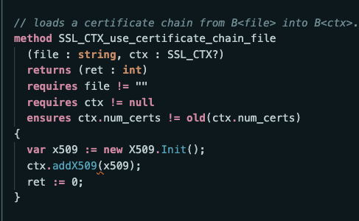
Place your screenshot here
Notes:
This slide shows an example of the high level concept explained in the previous slide

Slide 8
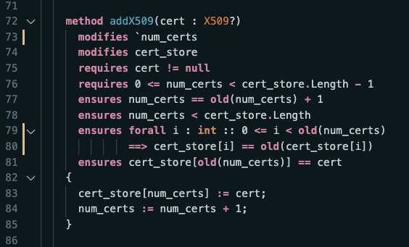
Place your screenshot here
Notes:
This slide and the next shows an example of the high level concept explained in the previous slide

Slide 9
Conclusion and What next?
The Secure Socket API is an effective way of guaranteeing a secure TLS connection
Formal verification of meaningful (non-trivial) code is hard
We lack formal verification that our model represents the codebase
Solution: Integrate proof into the codebase

Slide 10
thanks!
Any questions?

